Slide 2

The Story

Slide 3
My last 4 years :

Slide 4
The loss:
Broken
Stolen
Stolen

Slide 5
The Father:

Slide 6
The Family ‘Database’:

Slide 7
INSURE

Slide 9
“The User Experience”

Slide 10
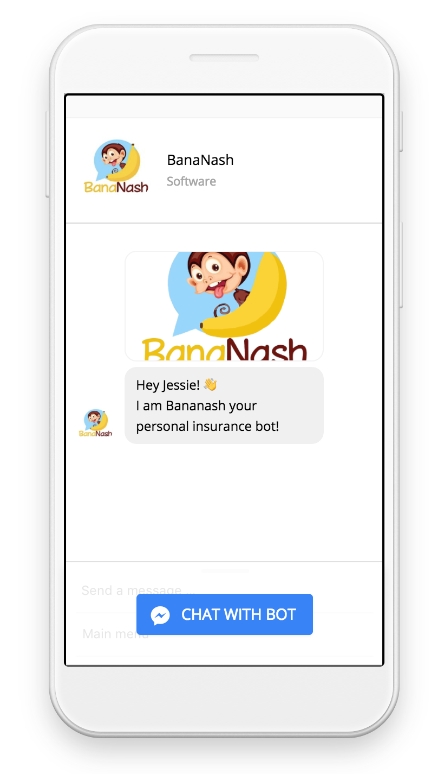
The Bananash Chat-bot:
User-Friendly interface
Increased Customer Engagement
Loads of choices
Best deal comparison

Slide 11
“The Insurance Company Dashboard”

Slide 12
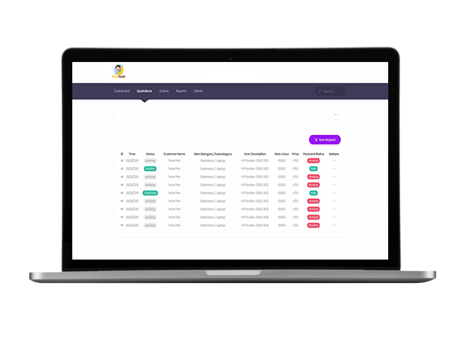
The Bananash Dashboard:
Analytics & tools
Increased Lead Generation
Quote Optimization
Easy KYC

Slide 14
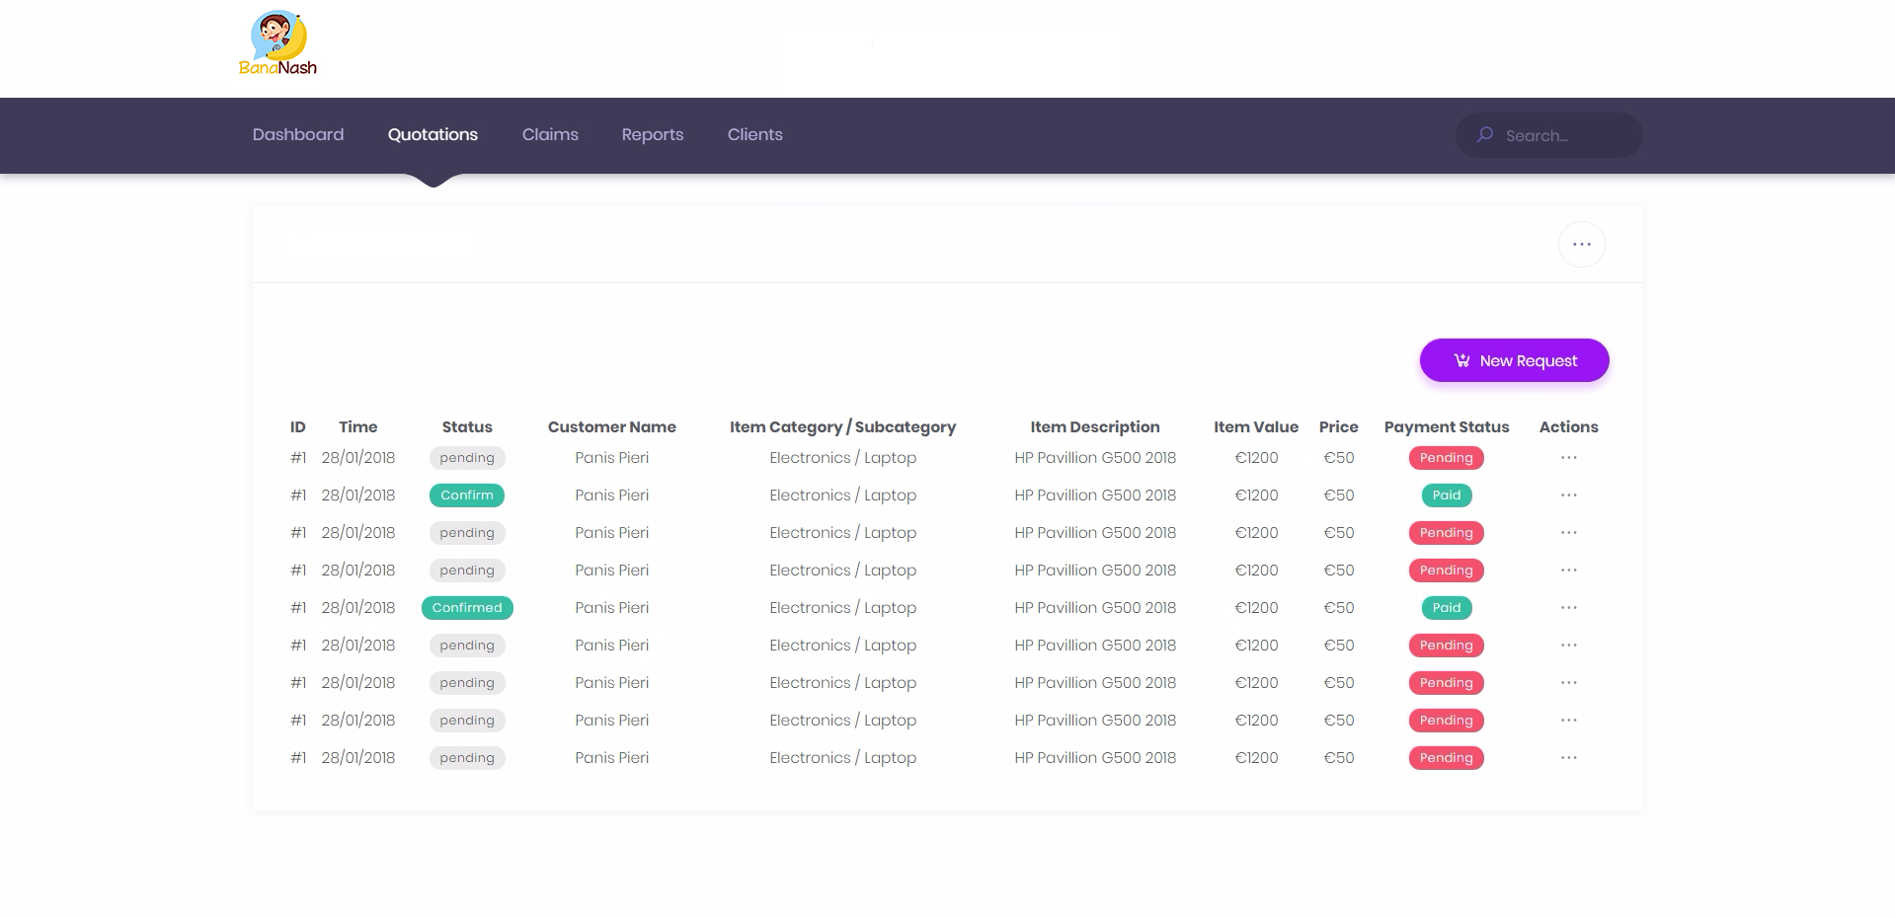

Slide 15
